Slide 1




SRM
Institute of Science and Technology
18CSC303J
Database Management System
Unit- IV

Slide 2

Relational Algebra

Slide 3
The relational algebra is a procedural query language.
Consists of a set of operations that take one or two relations as input and produce a new relation as their result.
The fundamental operations in the relational algebra are select, project, union, set difference, Cartesian product, and rename.
In addition to the fundamental operations, there are several other operations—namely, set intersection, natural join, and assignment.

Slide 4
Fundamental Operations
The select, project, and rename operations are called unary operations, because they operate on one relation.
The other three operations operate on pairs of relations and are, called binary operations.

Slide 5
The Select Operation
The select operation selects tuples that satisfy a given predicate.
Lowercase Greek letter sigma (σ) is used to denote selection.
The predicate appears as a subscript to σ.
The argument relation is in parentheses after the σ.
To select those tuples of the instructor relation where the instructor is in the “Physics” department, we write:

Slide 6
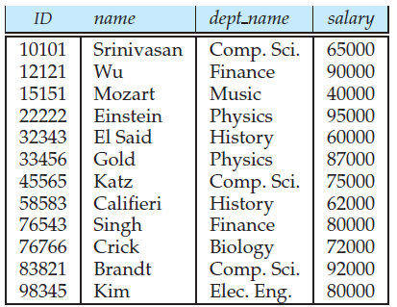
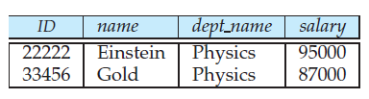

The instructor relation
Result of σ_{dept_name} =“Physics” (instructor )

Slide 7

Find all instructors with salary greater than $90,000.
ID | Name | Dept_Name | Salary
12121 | Wu | Finance | 90000
22222 | Einstein | Physics | 95000
83821 | Brandt | Comp. Sci. | 92000

Slide 8

The Select Operation
In general, we allow comparisons using =, ≠, <, ≤, >, and ≥ in the selection predicate.
We can combine several predicates into a larger predicate by using the connectives and (∧), or (∨), and not (¬).
To find the instructors in Physics with a salary greater than $90,000

Slide 9

The Select Operation
The selection predicate may include comparisons between two attributes.
To illustrate, consider the relation department.
To find all departments whose name is the same as their building name,

Slide 10
The Project Operation
Suppose we want to list all instructors’ ID, name, and salary, but do not care about the dept name.
The project operation allows us to produce this relation.
The project operation is a unary operation that returns its argument relation, with certain attributes left out.
Since a relation is a set, any duplicate rows are eliminated.
Projection is denoted by the uppercase Greek letter pi (Π).

Slide 11
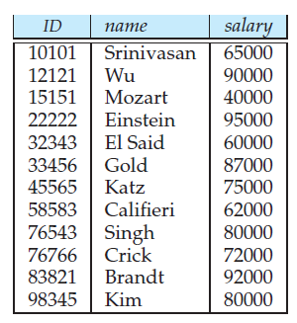

The Project Operation
We list those attributes that we wish to appear in the result as a subscript to Π.
The argument relation follows in parentheses.
We write the query to produce such a list

Slide 12

Composition of Relational Operations
The fact that the result of a relational operation is itself a relation is important.
Consider the more complicated query “Find the name of all instructors in the Physics department.”
Instead of giving the name of a relation as the argument of the projection operation,
  Give an expression that evaluates to a relation.

Slide 13
Composition of Relational Operations
In general, the result of a relational-algebra operation is of the same type (relation) as its inputs,
  relational-algebra operations can be composed together into a relational-algebra expression.
Composing relational-algebra operations into relational-algebra expressions
  composing arithmetic operations(such as+,−, ∗, and÷) into arithmetic expressions.

Slide 14
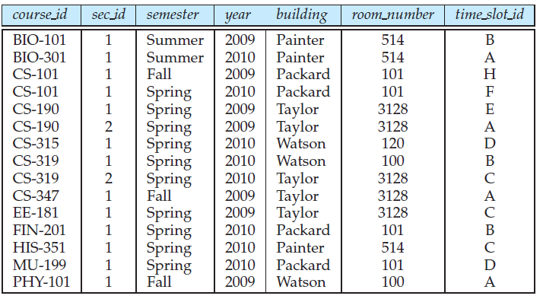
The Union Operation
Consider a query to find the set of all courses taught in the Fall 2009 semester, the Spring 2010 semester, or both.
The information is contained in the section relation as shown in figure.
The section relation

Slide 15


To find the set of all courses taught in the Fall 2009 semester
To find the set of all courses taught in the Spring 2010 semester

Slide 16
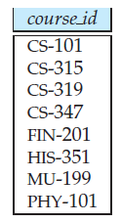

The Union Operation
To answer the query, we need the union of these two sets; that is, we need all section IDs that appear in either or both of the two relations.
We find these data by the binary operation union, denoted, as in set theory, by ∪.
The expression needed is

Slide 17
The Union Operation
There are 8 tuples in the result, even though there are 3 distinct courses offered in the Fall 2009 semester and 6 distinct courses offered in the Spring 2010 semester.
Since relations are sets, duplicate values such as CS-101, which is offered in both semesters, are replaced by a single occurrence.
A union operation r ∪ s to be valid, we require that two conditions hold:

Slide 18

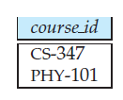
The Set-Difference Operation
denoted by −
allows us to find tuples that are in one relation but are not in another.
The expression r − s produces a relation containing those tuples in r but not in s.
find all the courses taught in the Fall 2009 semester but not in Spring 2010 semester

Slide 19
The Set-Difference Operation
must ensure that set differences are taken between compatible relations.
Therefore, for a set-difference operation r − s to be valid, we require that the relations r and s be of the same arity, and that the domains of the i^{th} attribute of r and the i^{th} attribute of s be the same, for all i.

Slide 20
The Cartesian-Product Operation
Denoted by a cross (×),
Allows us to combine information from any two relations.
We write the Cartesian product of relations r1 and r2 as r1 × r2.
Recall that a relation is by definition a subset of a Cartesian product of a set of domains.

Slide 21
The Cartesian-Product Operation
From that definition, we should already have an intuition about the definition of the Cartesian-product operation.
However, since the same attribute name may appear in both r1 and r2, we need to devise a naming schema to distinguish between these attributes.
We do so here by attaching to an attribute the name of the relation from which the attribute originally came.
For example, the relation schema for r = instructor × teaches is

Slide 22


With this schema, we can distinguish instructor.ID from teaches.ID.
For those attributes that appear in only one of the two schemas, we shall usually drop the relation-name prefix.
This simplification does not lead to any ambiguity.
We can then write the relation schema for r as:

Slide 23

The Rename Operation
Unlike relations in the database, the results of relational-algebra expressions do not have a name that we can use to refer to them.
It is useful to be able to give them names; the rename operator, denoted by the lowercase Greek letter rho (ρ),
Given a relational-algebra expression E, the expression
returns the result of expression E under the name x.

Slide 24

The Rename Operation
A relation r by itself is considered a (trivial) relational-algebra expression.
Apply the rename operation to a relation r to get the same relation under a new name.
A second form of the rename operation is as follows: Assume that a relational algebra expression E has arity n. Then, the expression
returns the result of expression E under the name x, and with the attributes renamed to A₁, A₂, . . . , A_{n}.

Slide 25
Formal Definition of the Relational Algebra
The operations allow us to give a complete definition of an expression in the relational algebra.
A basic expression in the relational algebra consists of either one of the following:
  A relation in the database
  A constant relation
A constant relation is written by listing its tuples within { },
for example { (22222, Einstein, Physics, 95000), (76543, Singh, Finance, 80000) }.

Slide 26
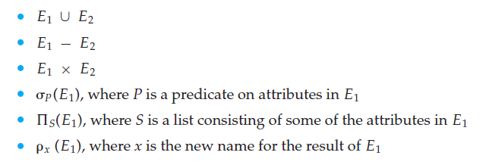
Formal Definition of the Relational Algebra
A general expression in the relational algebra is constructed out of smaller subexpressions.
Let E1 and E2 be relational-algebra expressions.
Then, the following are all relational-algebra expressions

Slide 27

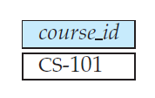
The Set-Intersection Operation
The first additional relational-algebra operation that we shall define is set intersection (∩).
Find the set of all courses taught in both the Fall 2009 and the Spring 2010 semesters.
Courses offered in both the Fall 2009 and Spring 2010 semesters

Slide 28

The Set-Intersection Operation
Rewrite any relational-algebra expression that uses set intersection
by replacing the intersection operation with a pair of set-difference operations
Set intersection is not a fundamental operation and does not add any power to the relational algebra.
It is simply more convenient to write r ∩ s than to write r − (r − s).

Slide 29
The Natural-Join Operation
The natural join is a binary operation that allows us to combine certain selections and a Cartesian product into one operation.
It is denoted by the join symbol
The natural-join operation forms a Cartesian product of its two arguments,
Performs a selection forcing equality on those attributes that appear in both relation schemas, and finally removes duplicate attributes.

Slide 30
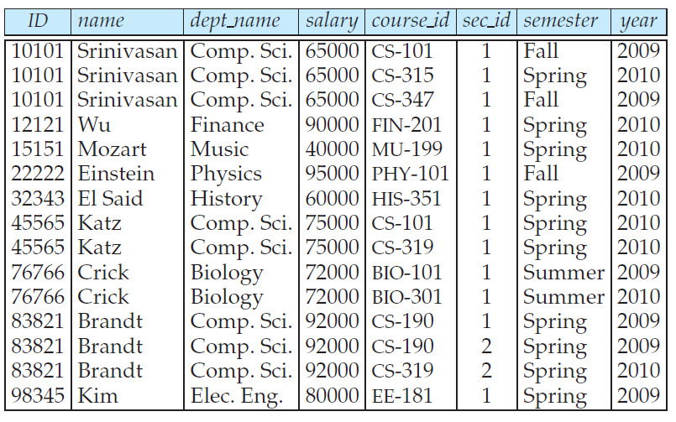
The Natural-Join Operation
The natural join of the instructor relation with the teaches relation

Slide 31
The Natural-Join Operation
The result relation, has only 13 tuples, the ones that give information about an instructor and a course that that instructor actually teaches.
We do not repeat those attributes that appear in the schemas of both relations; rather they appear only once.
Notice also the order in which the attributes are listed
  first the attributes common to the schemas of both relations,
  second those attributes unique to the schema of the first relation, and
  finally, those attributes unique to the schema of the second relation.

Slide 32

The Natural-Join Operation
The definition of natural join is complicated, the operation is easy to apply.
Find the names of all instructors together with the course id of all courses they taught.

Slide 33
The Natural-Join Operation
The schemas for instructor and teaches have the attribute ID in common,
  the natural-join operation considers only pairs of tuples that have the same value on ID.
It combines each such pair of tuples into a single tuple on the union of the two schemas; that is, (ID, name, dept name, salary, course id).
After performing the projection, we obtain the relation in Figure.

Slide 34
The Natural-Join Operation
Consider two relation schemas R and S—which are, of course, lists of attribute names.
If we consider the schemas to be sets, rather than lists,
  Denote those attribute names that appear in both R and S by R ∩ S,
  Denote those attribute names that appear in R, in S, or in both by R ∪ S.
Similarly, those attribute names that appear in R but not S are denoted by R − S, whereas S − R denotes those attribute names that appear in S but not in R.

Slide 35
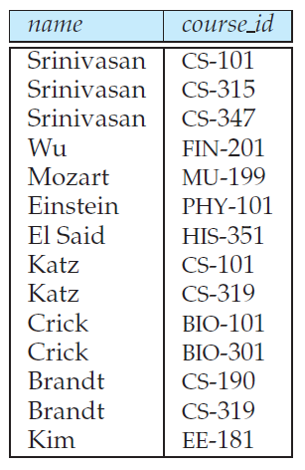
The Natural-Join Operation

Slide 36
Formal definition of the natural join
Consider two relations r (R) and s(S).
The natural join of r and s, denoted by r s, is a relation on schema R ∪ S formally defined as follows
where R ∩ S = {A₁, A₂, . . . , A_{n}}.
Please note that if r (R) and s(S) are relations without any attributes in common,
R ∩ S = ∅, then r s = r × s.

Slide 37
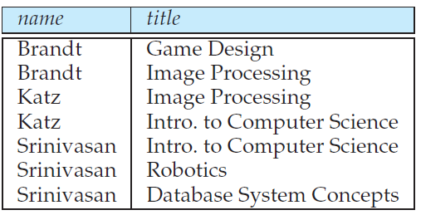

The Natural-Join Operation
Find the names of all instructors in the Comp. Sci. department together with the course titles of all the courses that the instructors teach.”

Slide 38

The Natural-Join Operation
we wrote instructor teaches course without inserting parentheses to specify the order in which the natural-join operations on the three relations should be executed.
The natural join is associative
The theta join operation is a variant of the natural-join operation that allows us to combine a selection and a Cartesian product into a single operation.

Slide 39
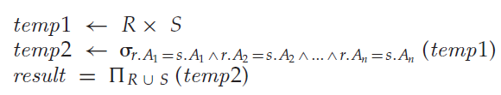
The Assignment Operation
It is convenient at times to write a relational-algebra expression by assigning parts of it to temporary relation variables.
The assignment operation, denoted by ←, works like assignment in a programming language.
To illustrate this operation, consider the definition of the natural-join operation.
We could write r s as:

Slide 40
The Assignment Operation
The evaluation of an assignment does not result in any relation being displayed to the user.
Rather, the result of the expression to the right of the ← is assigned to the relation variable on the left of the←.
This relation variable may be used in subsequent expressions.
With the assignment operation, a query can be written as a sequential program consisting of
  a series of assignments
  followed by an expression
  whose value is displayed as the result of the query.

Slide 41
The Assignment Operation
For relational-algebra queries, assignment must always be made to a temporary relation variable.
Assignments to permanent relations constitute a database modification.
The assignment operation does not provide any additional power to the algebra.
It is, a convenient way to express complex queries.

Slide 42
Outer join Operations
An extension of the join operation to deal with missing information.
Suppose that there is some instructor who teaches no courses.
The tuple in the “instructor relation” for that particular instructor would not satisfy the condition of a natural join with the “teaches relation”
instructor’s data would not appear in the result of the natural join, shown in Figure.

Slide 43
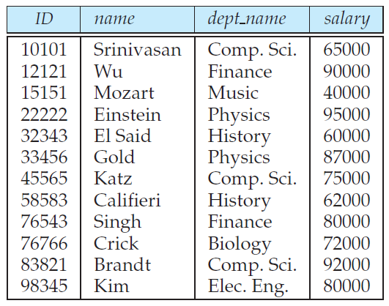
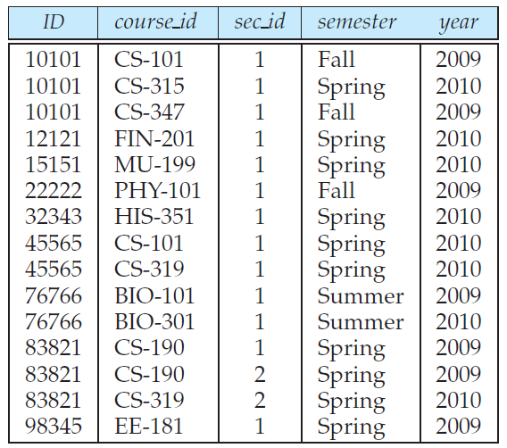
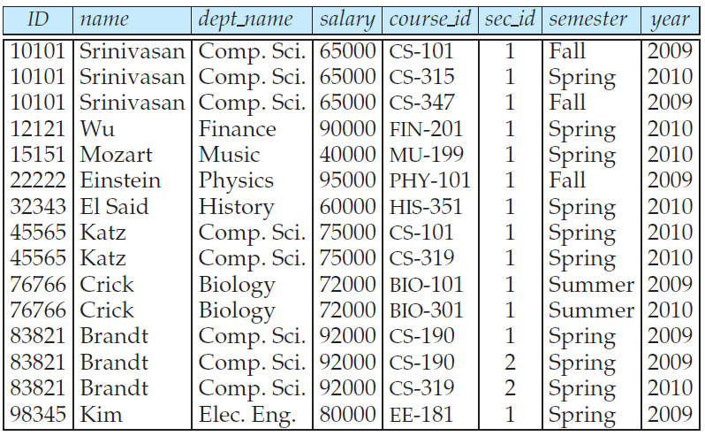
Outer join Operations
The instructor relation
The teaches relation
The natural join of the instructor relation with the teaches relation

Slide 44
Outer join Operations
For example,
instructors Califieri, Gold, and Singh do not appear in the result of the natural join, since they do not teach any course.
More generally, some tuples in either or both of the relations being joined may be “lost” in this way.
The outer join operation works in a manner similar to the natural join operation we have already studied, but preserves those tuples that would be lost in an join by creating tuples in the result containing null values.

Slide 45


Outer join Operations
use the outer-join operation to avoid this loss of information.
actually three forms of the operation:
  left outer join, denoted
  right outer join, denoted ; and
  full outer join, denoted .
All three forms of outer join compute the join, and add extra tuples to the result of the join.
For example, the results of the expression instructor teaches and teaches instructor appear in Figures

Slide 46
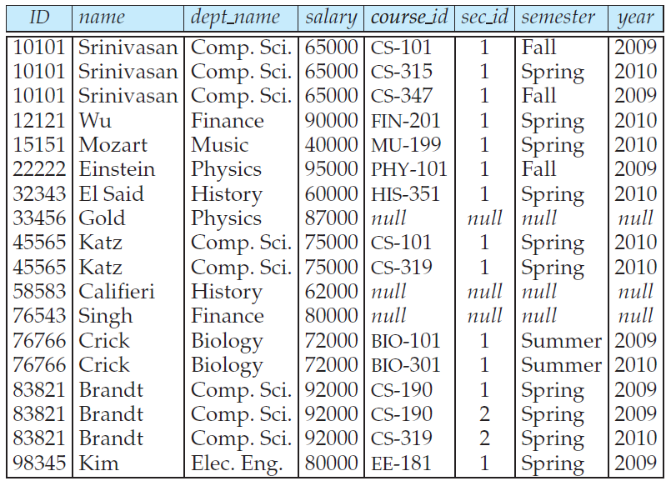
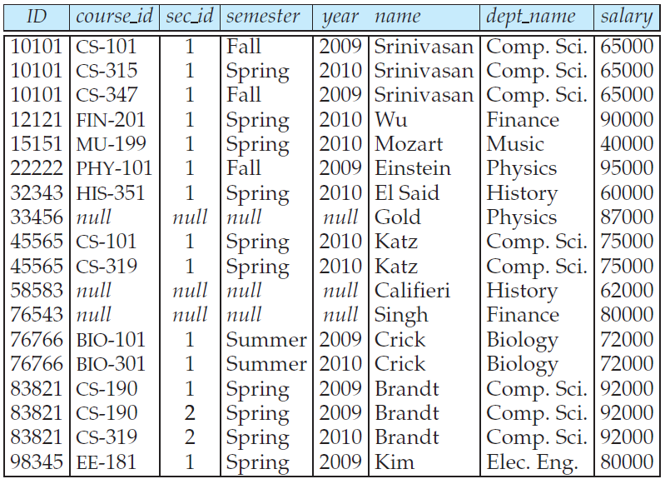



Slide 47
Left Outer join Operations
The left outer join takes all tuples in the left relation
  did not match with any tuple in the right relation,
  pads the tuples with null values for all other attributes from the right relation, and
  adds them to the result of the natural join.
In Figure, tuple (58583, Califieri, History, 62000, null, null, null, null), is such a tuple.
All information from the left relation is present in the result of the left outer join.

Slide 48
Right Outer join Operations
The right outer join is symmetric with the left outer join
It pads tuples from the right relation that
  did not match any from the left relation with nulls and
  adds them to the result of the natural join.
In Figure 6.18, tuple (58583, null, null, null, null, Califieri, History, 62000), is such a tuple.
Thus, all information from the right relation is present in the result of the right outer join.

Slide 49
Full Outer join Operations
The full outer join does both the left and right outer join operations,
  padding tuples from the left relation that did not match any from the right relation,
  as well as tuples from the right relation that did not match any from the left relation, and
  adding them to the result of the join.

Slide 50
Extended Relational-Algebra Operations
Relational-algebra operations provide the ability to write queries that cannot be expressed using the basic relational-algebra operations.
These operations are called extended relational-algebra operations.

Slide 51

Generalized Projection
Extends the projection operation by allowing operations such as arithmetic and string functions to be used in the projection list.
The generalized-projection operation has the form
where
  E is any relational-algebra expression,
  each of F₁, F₂, . . . , F_{n} is an arithmetic expression involving constants and attributes in the schema of E.

Slide 52

Generalized Projection
Generalized projection also permits operations on other data types, such as concatenation of strings.

Slide 53
Aggregation
The second extended relational-algebra operation is the aggregate operation ,
Permits the use of aggregate functions such as min or average, on sets of values.
Aggregate functions take a collection of values and return a single value as a result.
  Sum, Average, Count, Min, Max

Slide 54

The collections on which aggregate functions operate can have multiple occurrences of a value; the order in which the values appear is not relevant. Such collections are called multisets. Sets are a special case of multisets where there is only one copy of each element.
Find out the sum of salaries of all instructors
The result of the expression is a relation with a single attribute, containing a single row with a numerical value corresponding to the sum of the salaries of all instructors.

Slide 55
Aggregation
There are cases where we must eliminate multiple occurrences of a value before computing an aggregate function.
If we do want to eliminate duplicates,
  use the same function names
  with the addition of the hyphenated string “distinct” appended to the end of the function name
  for example, count-distinct

Slide 56
Find the total number of instructors who teach a course in the Spring 2010 semester.
The aggregate function “count-distinct” ensures that even if an instructor teaches ore than one course, she is counted only once in the result.

Slide 57

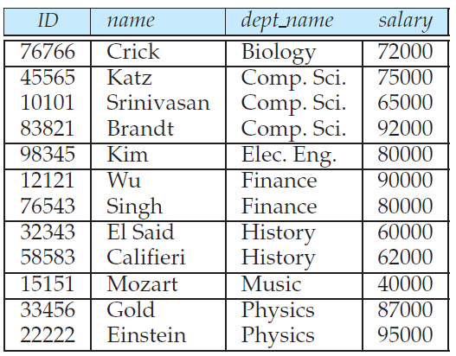
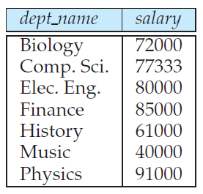
To apply the aggregate function not to a single set of tuples, but instead to a group of sets of tuples.
Find the average salary in each department
Tuples of the instructor relation, grouped by the dept name attribute
The result relation for the query “Find the average salary in each department”.

Slide 58
The Tuple Relational Calculus

Slide 59

The Tuple Relational Calculus
When we write a relational-algebra expression, we provide a sequence of procedures that generates the answer to our query.
The tuple relational calculus is a nonprocedural query language.
It describes the desired information without giving a specific procedure for obtaining that information.
A query in the tuple relational calculus is expressed as

Slide 60

The Tuple Relational Calculus
It is the set of all tuples “t” such that predicate “P” is true for “t”.
Following our earlier notation, we use t[A] to denote the value of tuple “t” on attribute A, and we use t ∈ r to denote that tuple t is in relation r.
Find the ID, name, dept name, salary for instructors whose salary is greater than $80,000

Slide 61
Pitfalls in Relational Database Design

Slide 62
Relational database design requires that we find a “good” collection of relation schemas.
A bad design may lead to
  Repetition of information.
  Inability to represent certain information.
Design Goals:
  Avoid redundant data
  Ensure that relationships among attributes are represented
  Facilitate the checking of updates for violation of database integrity constraints

Slide 63
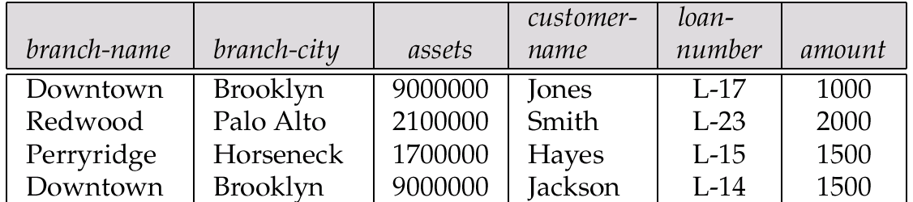
Example
Consider the relation schema:
Lending-schema = (branch-name, branch-city, assets, customer-name, loan-number, amount)

Slide 64
Example
Redundancy:
  Data for branch-name, branch-city, assets are repeated for each loan that a branch makes
  Wastes space and complicates updating
Null values
  Cannot store information about a branch if no loans exist
  Can use null values, but they are difficult to handle

Slide 65
Decomposition
Decompose the relation schema Lending-schema into:
  Branch-schema = (branch-name, branch-city, assets)
  Loan-info-schema = (customer-name, loan-number,
  branch-name, amount)
All attributes of an original schema (R) must appear in the decomposition (R1, R2):
R = R1 U R2
Lossless-join decomposition. For all possible relations r on schema R
r = ΠR1 (r) R2 (r)

Slide 66
Goal
Decide whether a particular relation R is in “good” form.
In the case that a relation R is not in “good” form,
  decompose it into a set of relations {R₁, R₂, ..., R_{n}} such that each relation is in good form
The decomposition is a lossless-join decomposition
Our theory is based on:
functional dependencies
multivalued dependencies

Slide 67
Decomposition
The only way to avoid the repetition-of-information problem in the in_dep schema is to decompose it into two schemas – instructor and department schemas.
Not all decompositions are good. Suppose we decompose
employee(ID, name, street, city, salary)
into
employee1 (ID, name)
employee2 (name, street, city, salary)
The problem arises when we have two employees with the same name
The next slide shows how we lose information -- we cannot reconstruct the original employee relation -- and so, this is a lossy decomposition
@ V.V.R

Slide 68
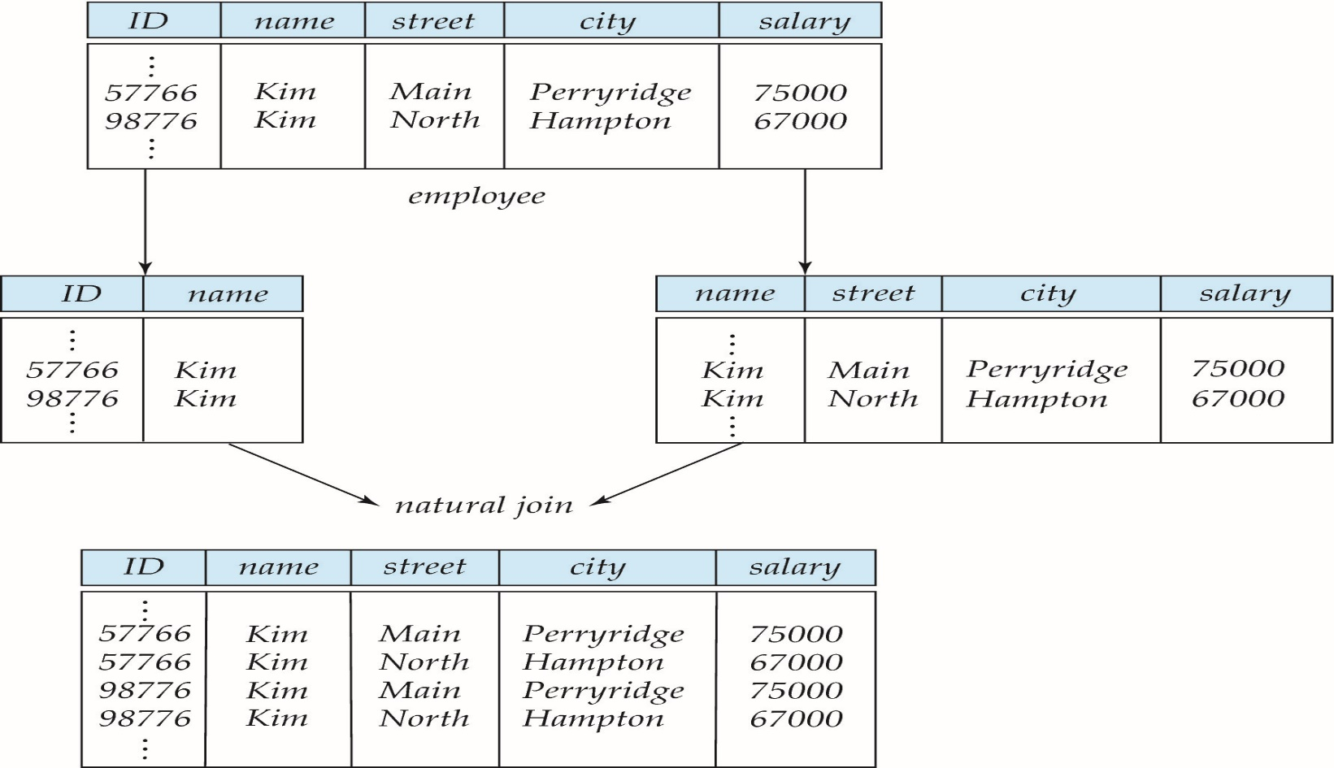
A Lossy Decomposition
@ V.V.R

Slide 69
Lossless Decomposition
Let R be a relation schema and let R₁ and R₂ form a decomposition of R . That is R = R₁ U R₂
We say that the decomposition is a lossless decomposition if there is no loss of information by replacing R with the two relation schemas R₁ U R₂
Formally,
∏ _{R1} (r) ∏ _{R2} (r) = r
And, conversely a decomposition is lossy if
  r ⊂ ∏ _{R1} (r) ∏ _{R2} (r) = r
@ V.V.R

Slide 70
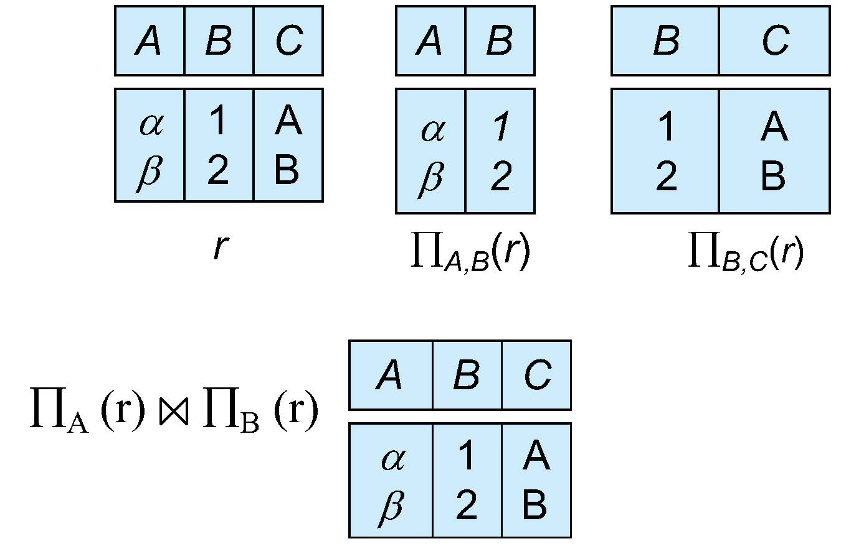
Examples of Lossless Decomposition
Decomposition of R = (A, B, C)
R₁ = (A, B) R₂ = (B, C)
@ V.V.R

Slide 71
Normalization theory
Decide whether a particular relation R is in “good” form.
In the case that a relation R is not in “good” form, decompose it into set of relations {R₁, R₂, ..., R_{n}} such that
  Each relation is in good form
  The decomposition is a lossless decomposition
Our theory is based on:
  Functional dependencies
  Multivalued dependencies
@ V.V.R

Slide 72
Normalization
The process of normalization is a formal method that identifies relational schemas based upon their primary or candidate keys and the functional dependencies that exists amongst their attributes.
Normalization is primarily a tool to validate and improve a logical design so that it satisfies certain constraints that avoid unnecessary duplication of data.
Normalization is the process of decomposing relation with anomalies to produce smaller, well-structured relations.
Normalisation should remove redundancy, but not at the expense of data integrity.
@ V.V.R

Slide 73
Transforming data from a problem into relations while ensuring data integrity and eliminating data redundancy.
  Data integrity : consistent and satisfies data constraint rules
  Data redundancy: if data can be found in two places in a single database (direct redundancy) or calculated using data from different parts of the database (indirect redundancy) then redundancy exists.
Normalisation should remove redundancy, but not at the expense of data integrity.
@ V.V.R

Slide 74
First Normal form
Domain is atomic if its elements are considered to be indivisible units
  Examples of non-atomic domains:
    Set of names, composite attributes
    Identification numbers like CS101 that can be broken up into parts
A relational schema R is in first normal form if the domains of all attributes of R are atomic
Non-atomic values complicate storage and encourage redundant (repeated) storage of data
  Example: Set of accounts stored with each customer, and set of owners stored with each account
@ V.V.R

Slide 75
First normal form (1NF) deals with the `shape' of the record.
A relation is in 1NF if, and only if, it contains no repeating attributes or groups of attributes.
Example:
  The Student table with the repeating group is not in 1NF
  It has repeating groups, it is an `unnormalised table'.
To remove the repeating group, either:
  flatten the table and extend the key, or
  decompose the relation- leading to First Normal Form
@ V.V.R

Slide 76
Flatten Table and Extend Primary Key
The Student table with the repeating group can be written as:
  Student(matric_no, name, date_of_birth, ( subject, grade ) )
If the repeating group was flattened, it would look something like:
  Student(matric_no, name, date_of_birth, subject, grade )
This does not have repeating groups, but has redundancy. For every matric_no/subject combination, the student name and date of birth is replicated. This can lead to errors.
Redundant data is the main cause of insertion, deletion, and updating anomalies.
  Insertion anomaly – Subject is now in the primary key, we cannot add a student until they have at least one subject. Remember, no part of a primary key can be NULL.
  Update anomaly – changing the name of a student means finding all rows of the database where that student exists and changing each one separately.
  Deletion anomaly- for example deleting all database subject information also deletes student 960145.
@ V.V.R

Slide 77
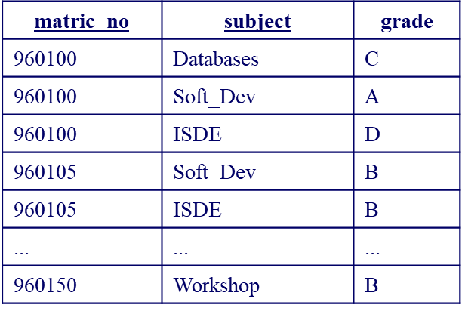
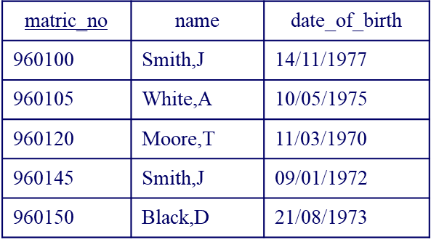
Decomposing Relation
The alternative approach is to split the table into two parts, one for the repeating groups and one of the non-repeating groups.
The primary key for the original relation is included in both of the new relations
Record: Student
@ V.V.R

Slide 78
We now have two relations, Student and Record.
  Student contains the original non-repeating groups
  Record has the original repeating groups and the matric_no
Student(matric_no, name, date_of_birth )
Record(matric_no, subject, grade )
This version of the relations does not have insertion, deletion, or update anomalies.
Without repeating groups, we say the relations are in First Normal Form (1NF).
@ V.V.R

Slide 79
Second Normal Form
A relation is in 2NF if, and only if, it is in 1NF and every non-key attribute is fully functionally dependent on the whole key.
Thus the relation is in 1NF with no repeating groups, and all non-key attributes must depend on the whole key, not just some part of it. Another way of saying this is that there must be no partial key dependencies (PKDs).
The problems arise when there is a compound key, e.g. the key to the Record relation - matric_no, subject. In this case it is possible for non-key attributes to depend on only part of the key - i.e. on only one of the two key attributes. This is what 2NF tries to prevent.
@ V.V.R

Slide 80
Consider again the Student relation from the flattened table:
Student(matric_no, name, date_of_birth, subject, grade )
There are no repeating groups, so the relation is in 1NF
However, we have a compound primary key - so we must check all of the non-key attributes against each part of the key to ensure they are functionally dependent on it.
  matric_no determines name and date_of_birth, but not grade.
  subject together with matric_no determines grade, but not name or date_of_birth.
So there is a problem with potential redundancies
@ V.V.R

Slide 81
Dependency Diagram
A dependency diagram is used to show how non-key attributes relate to each part or combination of parts in the primary key.
Student
matric_no
name
date_of_bith
subject
grade
PKD
Fully Dependent

Slide 82
This relation is not in 2NF
  It appears to be two tables squashed into one.
  the solutions is to split the relation into component parts.
separate out all the attributes that are solely dependent on matric_no - put them in a new Student_details relation, with matric_no as the primary key
separate out all the attributes that are solely dependent on subject - in this case no attributes are solely dependent on subject.
separate out all the attributes that are solely dependent on matric_no + subject - put them into a separate Student relation, keyed on matric_no + subject
Student Details
matrix_no
name
date_of_birth
All attributes in each relation are fully functionally dependent upon its primary key
These relations are now in 2NF
Student
matrix_no
subject
grade

Slide 83
Third Normal Form
3NF is an even stricter normal form and removes virtually all the redundant data :
A relation is in 3NF if, and only if, it is in 2NF and there are no transitive functional dependencies
Transitive functional dependencies arise:
  when one non-key attribute is functionally dependent on another non-key attribute:
    FD: non-key attribute -> non-key attribute
  and when there is redundancy in the database
By definition transitive functional dependency can only occur if there is more than one non-key field, so we can say that a relation in 2NF with zero or one non-key field must automatically be in 3NF

Slide 84
project_no | manager | address |  | Project has more than one non-key field so we must check for transitive dependency:
p1 | Black,B | 32 High Street
p2 | Smith,J | 11 New Street
p3 | Black,B | 32 High Street
p4 | Black,B | 32 High Street

Slide 85
Address depends on the value of manager.
From the table we can propose:
  Project(project_no, manager, address)
  manager -> address
In this case address is transitively dependent on manager. The primary key is project_no, but the LHS and RHS have no reference to this key, yet both sides are present in the relation.
Data redundancy arises from this
  we duplicate address if a manager is in charge of more than one project
  causes problems if we had to change the address- have to change several entries, and this could lead to errors.

Slide 86
Eliminate transitive functional dependency by splitting the table
  create two relations - one with the transitive dependency in it, and another for all of the remaining attributes.
  split Project into Project and Manager.
the determinant attribute becomes the primary key in the new relation - manager becomes the primary key to the Manager relation
the original key is the primary key to the remaining non-transitive attributes - in this case, project_no remains the key to the new Projects table.

Slide 87
Now we need to store the address only once
If we need to know a manager's address we can look it up in the Manager relation
The manager attribute is the link between the two tables, and in the Projects table it is now a foreign key.
These relations are now in third normal form.
Project | project_no | manager
 | p1 | Black,B
 | p2 | Smith,J
 | p3 | Black,B
 | p4 | Black,B
Manager | manager | address
 | Black,B | 32 High Street
 | Smith,J | 11 New Street

Slide 88
BOYCE CODD NORMAL FORM
Many practitioners argue that placing entities in 3NF is generally sufficient because it is rare that entities that are in 3NF are not also in 4NF and 5NF
  The advanced forms of normalization are:
    Boyce-Codd Normal Form
    Fourth Normal Form
    Fifth Normal Form

Slide 89
BOYCE CODD NORMAL FORM
Boyce-Codd normal form (BCNF) is a more rigorous version of 3NF.
BCNF is based on the concept of determinants. A determinant column is one on which some of the columns are fully functionally dependent.
A relational table is in BCNF if and only if every determinant is a candidate key.

Slide 90
Boyce-Codd Normal Form (BCNF)
Examples
Example 1 - Address (Not in BCNF)
Scheme → {City, Street, ZipCode }
  Key1 → {City, Street }
  Key2 → {ZipCode, Street}
  No non-key attribute hence 3NF
  {City, Street} → {ZipCode}
  {ZipCode} → {City}
  Dependency between attributes belonging to a key
Notes:
The second and third normal forms assume that all attributes not part of the candidate keys depend on the candidate keys but does not deal with dependencies within the keys. BCNF deals with such dependencies.
Under third normal form all non-key columns must be functionally dependent on a candidate key. Under BCNF, even columns that are part of a candidate key must be dependent on another candidate key, if they have a dependency at all.
For most tables third normal form and BCNF are the same. Third normal form does not cover some specific cases for which BCNF was created. Third normal form and BCNF are not same if the following conditions are true:
The table has two or more candidate keys
At least two of the candidate keys are composed of more than one attribute
The keys are not disjoint i.e. The composite candidate keys share some attributes

Slide 91
Boyce Codd Normal Form (BCNF)
Example 2 - Movie (Not in BCNF)
Scheme → {MovieTitle, MovieID, PersonName, Role, Payment }
  Key1 → {MovieTitle, PersonName}
  Key2 → {MovieID, PersonName}
  Both role and payment functionally depend on both candidate keys thus 3NF
  {MovieID} → {MovieTitle}
  Dependency between MovieID & MovieTitle Violates BCNF
Example 3 - Consulting (Not in BCNF)
Scheme → {Client, Problem, Consultant}
  Key1 → {Client, Problem}
  Key2 → {Client, Consultant}
  No non-key attribute hence 3NF
  {Client, Problem} → {Consultant}
  {Client, Consultant} → {Problem}
  Dependency between attributess belonging to keys violates BCNF
Notes:
A management consulting firm has several clients and consultants. A client can have several problems and the same problem can be an issue for several clients. Each consultant specializes in only one problem type (e. g marketing, production) but several consultants could advise on one problem. For each problem, the client is advised by only one consultant.

Slide 92
BCNF - Decomposition
Place the two candidate primary keys in separate entities
Place each of the remaining data items in one of the resulting entities according to its dependency on the primary key.
Example 1 (Convert to BCNF)
  Old Scheme → {City, Street, ZipCode }
  New Scheme1 → {ZipCode, Street}
  New Scheme2 → {City, Street}
Loss of relation {ZipCode} → {City}
  Alternate New Scheme1 → {ZipCode, Street }
  Alternate New Scheme2 → {ZipCode, City}
Notes:
If there is a table with columns A,B,C with Primary Key (A) and C is dependant on B (B → C) then to be 3NF, the tables become
Table with columns B,C with Primary Key (B)
Table with fields A,B with Primary Key ( A), and Foreign Key (B)

Slide 93
Decomposition – Loss of Information
If decomposition does not cause any loss of information it is called a lossless decomposition.
If a decomposition does not cause any dependencies to be lost it is called a dependency-preserving decomposition.
Any table scheme can be decomposed in a lossless way into a collection of smaller schemas that are in BCNF form. However the dependency preservation is not guaranteed.
Any table can be decomposed in a lossless way into 3rd normal form that also preserves the dependencies.
  3NF may be better than BCNF in some cases
Use your own judgment when decomposing schemas

Slide 94
BCNF - Decomposition
Example 2 (Convert to BCNF)
  Old Scheme → {MovieTitle, MovieID, PersonName, Role, Payment }
  New Scheme → {MovieID, PersonName, Role, Payment}
  New Scheme → {MovieTitle, PersonName}
Loss of relation {MovieID} → {MovieTitle}
  New Scheme → {MovieID, PersonName, Role, Payment}
  New Scheme → {MovieID, MovieTitle}
We got the {MovieID} → {MovieTitle} relationship back
Example 3 (Convert to BCNF)
  Old Scheme → {Client, Problem, Consultant}
  New Scheme → {Client, Consultant}
  New Scheme → {Client, Problem}

Slide 95
Fourth Normal Form (4NF)
Fourth normal form eliminates independent many-to-one relationships between columns.
To be in Fourth Normal Form,
  a relation must first be in Boyce-Codd Normal Form.
  a given relation may not contain more than one multi-valued attribute.
Example (Not in 4NF)
  Scheme → {MovieName, ScreeningCity, Genre)
  Primary Key: {MovieName, ScreeningCity, Genre)
  All columns are a part of the only candidate key, hence BCNF
  Many Movies can have the same Genre
  Many Cities can have the same movie
  Violates 4NF
Movie
ScreeningCity
Genre
Hard Code
Los Angles
Comedy
Hard Code
New York
Comedy
Bill Durham
Santa Cruz
Drama
Bill Durham
Durham
Drama
The Code Warrier
New York
Horror

Slide 96
Fourth Normal Form (4NF)
Example 2 (Not in 4NF)
Scheme → {Manager, Child, Employee}
  Primary Key → {Manager, Child, Employee}
  Each manager can have more than one child
  Each manager can supervise more than one employee
  4NF Violated
Example 3 (Not in 4NF)
Scheme → {Employee, Skill, ForeignLanguage}
  Primary Key → {Employee, Skill, Language }
  Each employee can speak multiple languages
  Each employee can have multiple skills
  Thus violates 4NF
Manager
Child
Employee
Jim
Beth
Alice
Mary
Bob
Jane
Mary
NULL
Adam
Employee
Skill
Language
1234
Cooking
French
1234
Cooking
German
1453
Carpentry
Spanish
1453
Cooking
Spanish
2345
Cooking
Spanish
Notes:
These cause update, addition and deletion anomalies.
Insertion anomaly is that entity integrity would be violated if you tried to add a new employee who did not speak a foreign language.
Update anomalies would occur if you tried to change Cooking to Chef.

Slide 97
4NF - Decomposition
Move the two multi-valued relations to separate tables
Identify a primary key for each of the new entity.
Example 1 (Convert to 3NF)
  Old Scheme → {MovieName, ScreeningCity, Genre}
  New Scheme → {MovieName, ScreeningCity}
  New Scheme → {MovieName, Genre}
Movie
Genre
Movie
ScreeningCity
Hard Code
Comedy
Hard Code
Los Angles
Bill Durham
Drama
Hard Code
New York
The Code Warrier
Horror
Bill Durham
Santa Cruz
Bill Durham
Durham
The Code Warrier
New York

Slide 98
4NF - Decomposition
Example 2 (Convert to 4NF)
  Old Scheme → {Manager, Child, Employee}
  New Scheme → {Manager, Child}
  New Scheme → {Manager, Employee}
Example 3 (Convert to 4NF)
  Old Scheme → {Employee, Skill, ForeignLanguage}
  New Scheme → {Employee, Skill}
  New Scheme → {Employee, ForeignLanguage}
Manager
Child
Manager
Employee
Jim
Beth
Jim
Alice
Mary
Bob
Mary
Jane
Mary
Adam
Employee
Skill
Employee
Language
1234
Cooking
1234
French
1453
Carpentry
1234
German
1453
Cooking
1453
Spanish
2345
Cooking
2345
Spanish

Slide 99
Multivalued Dependencies and Fourth Normal Form
Definition:
A multivalued dependency (MVD) X —>> Y specified on relation schema R, where X and Y are both subsets of R, specifies the following constraint on any relation state r of R: If two tuples t₁ and t₂ exist in r such that t₁[X] = t₂[X], then two tuples t₃ and t₄ should also exist in r with the following properties, where we use Z to denote (R 2 (X υ Y)):
  t₃[X] = t₄[X] = t₁[X] = t₂[X].
  t₃[Y] = t₁[Y] and t₄[Y] = t₂[Y].
  t₃[Z] = t₂[Z] and t₄[Z] = t₁[Z].
An MVD X —>> Y in R is called a trivial MVD if (a) Y is a subset of X, or (b) X υ Y = R.

Slide 100
Multivalued Dependencies and Fourth Normal Form
Definition:
A relation schema R is in 4NF with respect to a set of dependencies F (that includes functional dependencies and multivalued dependencies) if, for every nontrivial multivalued dependency X —>> Y in F⁺, X is a superkey for R.
  Note: F⁺ is the (complete) set of all dependencies (functional or multivalued) that will hold in every relation state r of R that satisfies F. It is also called the closure of F.

Slide 101
Join Dependency
What is join dependency?
If a table can be recreated by joining multiple tables and each of this table have a subset of the attributes of the table, then the table is in Join Dependency.
It is a generalization of Multivalued Dependency
If the join of R1 and R2 over C is equal to relation R, then we can say that a join dependency (JD) exists.
Where R1 and R2 are the decompositions R1(A, B, C) and R2(C, D) of a given relations R (A, B, C, D).
Alternatively, R1 and R2 are a lossless decomposition of R.
A JD ⋈ {R1, R2,..., Rn} is said to hold over a relation R if R1, R2,....., Rn is a lossless-join decomposition.
The *(A, B, C, D), (C, D) will be a JD of R if the join of join's attribute is equal to the relation R.
Here, *(R1, R2, R3) is used to indicate that relation R1, R2, R3 and so on are a JD of R.

Slide 102
Example: <employee>
Empname | EmpSkills | EmpJob (Assigned Work)
Tom | Networking | EJ001
Harry | Web Development | EJ002
Katie | Programming | EJ002
The table can be decomposed into 3 tables
<EmployeeSkills>
Emp Name | EmpSkills
Tom | Networking
Harry | Web Development
Katie | Programming

Slide 103
<EmployeeJob>
EmpName | EmpJob
Tom | EJ001
Harry | EJ002
Katie | EJ002
<JobSkills>
EmpSkills | EmpJob
Networking | EJ001
Web Development | EJ002
Programming | EJ002
Join dependency
{(EmpName, EmpSkills ), ( EmpName, EmpJob), (EmpSkills, EmpJob)}

Slide 104
Fifth Normal Form-5NF
A relation is in 5NF if it is in 4NF and not contains any join dependency and joining should be lossless.
5NF is satisfied when all the tables are broken into as many tables as possible in order to avoid redundancy.
5NF is also known as Project-join normal form (PJ/NF).
Example:
SUBJECT | LECTURER | SEMESTER
Computer | Anshika | Semester 1
Computer | John | Semester1
Math | John | Semester 1
Math | Akash | Semester 2
Chemistry | Praveen | Semester 1

Slide 105
5NF- Continued
In the above table, John takes both Computer and Math class for Semester 1 but he doesn't take Math class for Semester 2. In this case, combination of all these fields required to identify a valid data.
Suppose we add a new Semester as Semester 3 but do not know about the subject and who will be taking that subject so we leave Lecturer and Subject as NULL. But all three columns together acts as a primary key, so we can't leave other two columns blank.
So to make the above table into 5NF, we can decompose it into three relations P1, P2 & P3.

Slide 106
5NF-Continued
P1
P2
SEMESTER | SUBJECT
Semester 1 | Computer
Semester 1 | Math
Semester 1 | Chemistry
Semester 2 | Math
SUBJECT | LECTURER
Computer | Anshika
Computer | John
Math | John
Math | Akash
Chemistry | Praveen
P3
SEMESTER | LECTURER
Semester 1 | Anshika
Semester 1 | John
Semester 1 | John
Semester 2 | Akash
Semester 1 | Praveen

